Slide 1
Computer Network
Guided Media

Slide 2
Guided Media
Guided media includes everything that ‘guides’ the transmission. That usually takes the form of some sort of a wire. Usually copper, but can also be an optical fiber.

Slide 3
Twisted Pair Cable
A transmission medium consisting of pairs of twisted copper wires.
We can transmit 1 Mbps over short distances (less than 100m).
They are mainly used to transmit analog signals, but they can be used for digital signals.

Slide 4
Types of Twisted Pair Cable
Unshielded Twisted Pair (UTP)
Shielded Twisted Pair (STP)

Slide 5
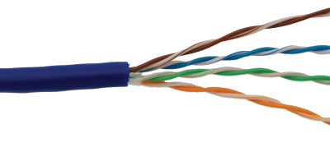
Unshielded Twisted Pair
Unshielded twisted pair (UTP) cables are widely used in the computer and telecommunications industry as Ethernet cables and telephone wires.
In an UTP cable, conductors which form a single circuit are twisted around each other in order to cancel out electromagnetic interference (EMI) from external sources. Unshielded means no additional shielding like meshes or aluminum foil, which add bulk, are used.
UTP cables are often groups of twisted pairs grouped together with color coded insulators, the number of which depends on the purpose.

Slide 6
Categories of unshielded twisted-pair cables

Slide 7
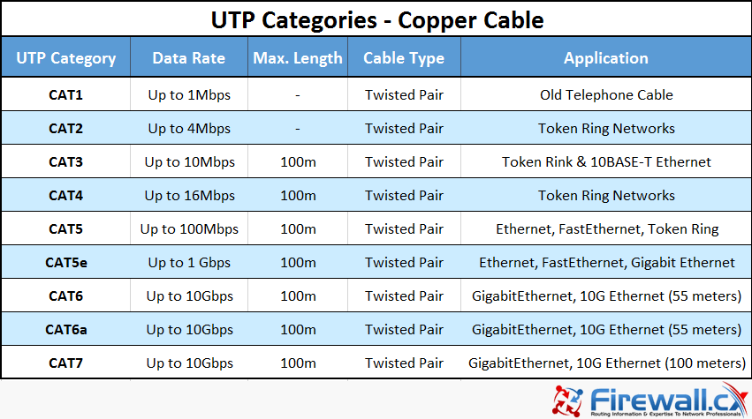

Slide 8
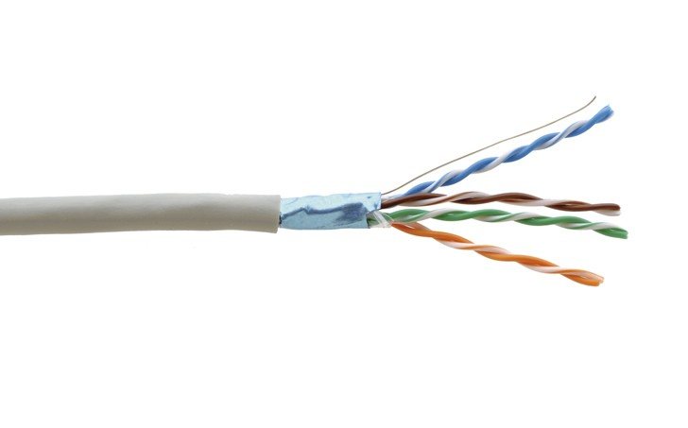
shielded Twisted Pair
Shielded twisted pair (STP) cable was originally designed by IBM for token ring networks that include two individual wires covered with a foil shielding, which prevents electromagnetic interference, thereby transporting data faster.
STP is similar to unshielded twisted pair (UTP); however, it contains an extra foil wrapping or copper braid jacket to help shield the cable signals from interference. STP cables are costlier when compared to UTP, but has the advantage of being capable of supporting higher transmission rates across longer distances.

Slide 9
Coaxial Cable
Coaxial consists of a core made of solid copper surrounded by insulation, a braided metal shielding, and an outer cover.
This media is used in base band and broadband transmission.
Coaxial cables do not produce external electric and magnetic fields and are not affected by them.
This makes them ideally suited, although more expensive, for transmitting signals.

Slide 10
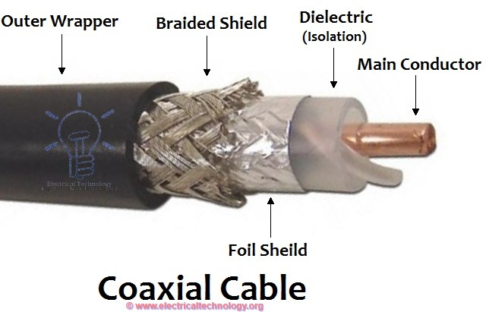

Slide 11
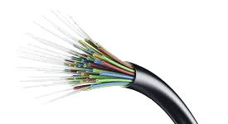
Optical Fiber cable
Optical fiber consists of a glass core, surrounded by a glass cladding with slightly lower refractive index.
In most networks fiber-optic cable is used as the high-speed backbone, and twisted wire and coaxial cable are used to connect the backbone to individual devices.
Mode of propagation in optical fiber cable:
Single Mode
Multi Mode

Slide 12
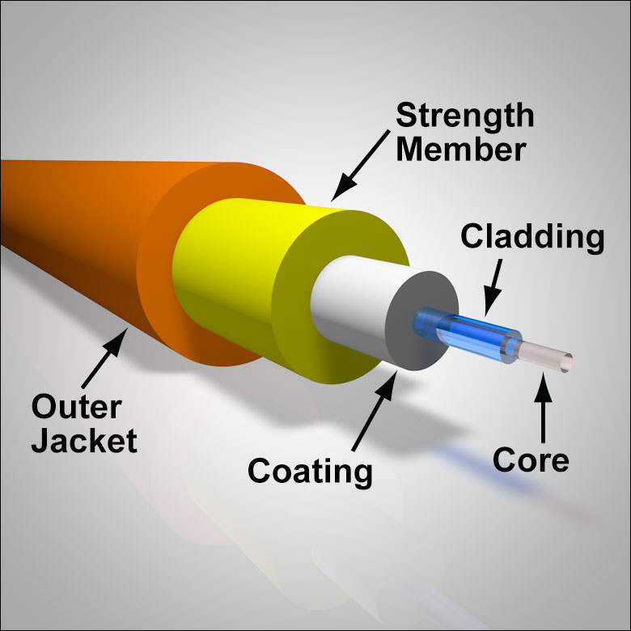

Slide 13
